Slide 1
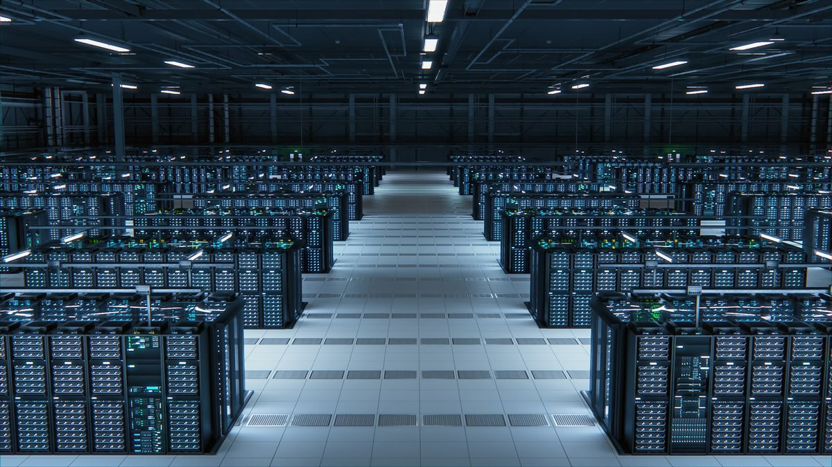
The Data Center–Swimming Pool Energy Loop
Yousef

Slide 2

The Problem
Data centers generate a lot of heat
Swimming pools require a lot of energy to stay warm
Both facilities spend money solving opposite problems

Slide 3
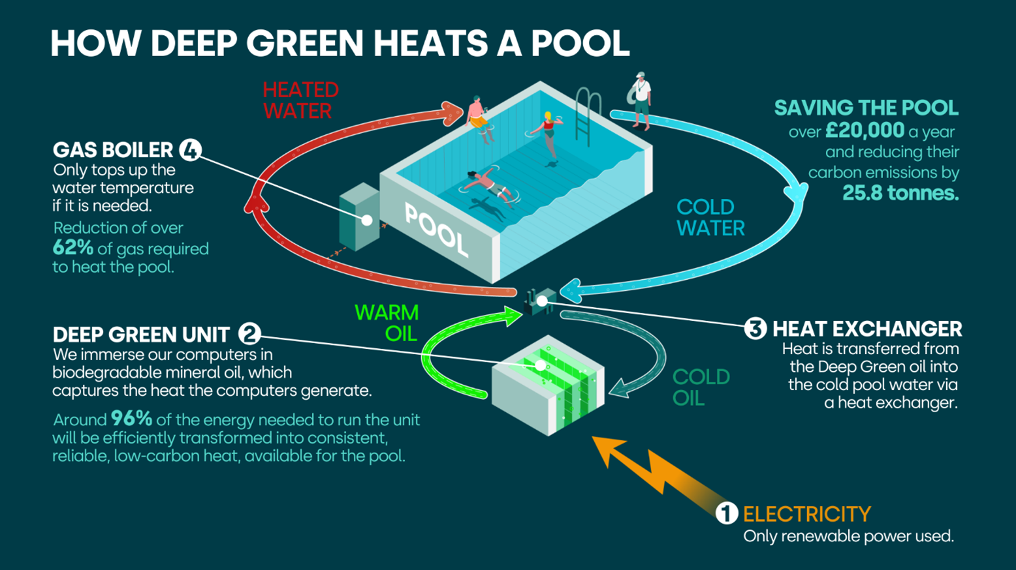
The Solution
Capture heat from the data center
Transfer it through a heat exchanger
Use the heat to warm the swimming pool
Cooler liquid returns to the data center
Pool water and server cooling liquid never mix

Slide 4
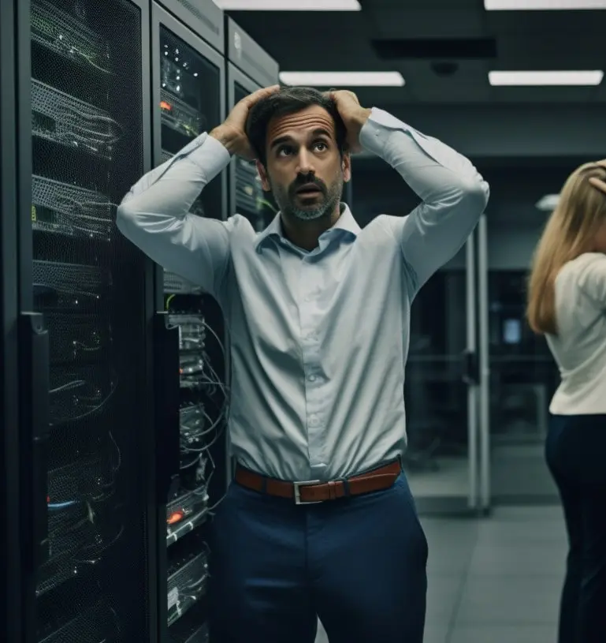
Challenges & Questions
Data center and pool need to be relatively close
What happens when the pool does not need more heat?
Backup cooling and heating systems are still needed
Installation costs could be high
How much money and energy would actually be saved?

Slide 5
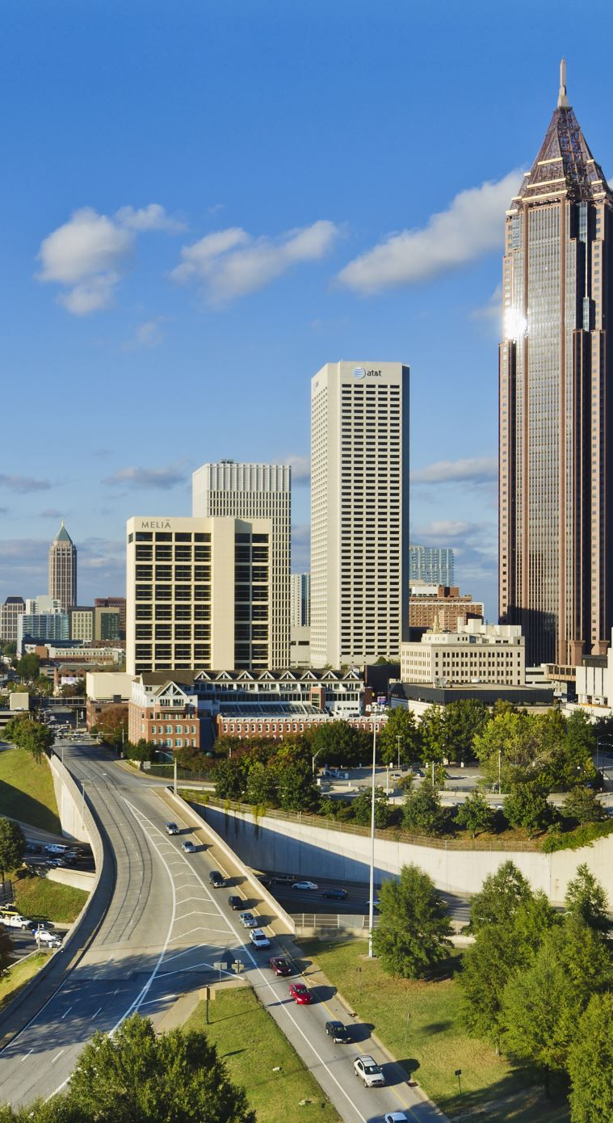
Scalability
Start with one data center + one community pool
Expand to gyms, schools, apartments, and hospitals
Excess heat could support entire neighborhoods
Could become part of a district heating network
Strongest in areas with many data centers and year-round heating demand

Slide 6

In Conclusion
Data centers have too much heat
Community facilities need heat
Connecting them reduces waste and energy costs
Creates both environmental and community benefits

